Slide 1


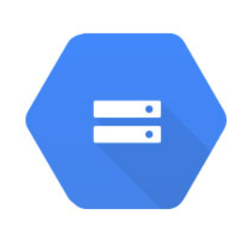



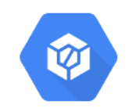









High Level Solution Architecture
Customer Table Policy Table Agent Table
External Data Table
Pipeline Orchestration and Automation
Cloud Storage
Cloud Source Repository
Models & pipelines
Cloud Build
Params & metrics
Cloud SQL
Model Re-training
Cloud SQL
Cloud Run
Container Registry
Monthly Customer Lapse Prediction
Web API
Data Drift and Model Drift Monitoring
Explainable AI with SHAP chart
Due Base
What-if Tool

